Slide 1
Deploy Python to the cloud faster with Azure Serverless
Jeff Hollan
@jeffhollan

Slide 2
How did you get here today?
Buy a car
Rent a car
Rideshare
IaaS / VM
PaaS
Serverless

Slide 3
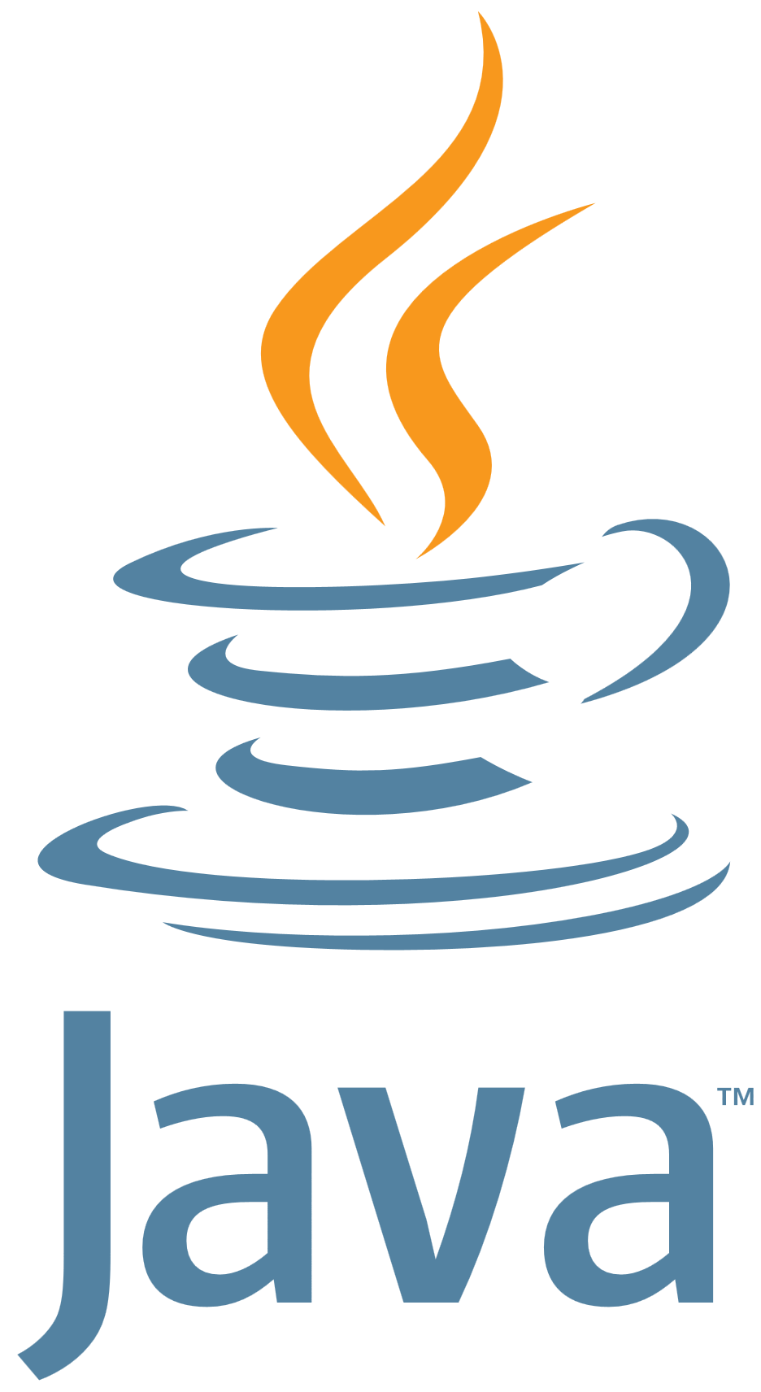
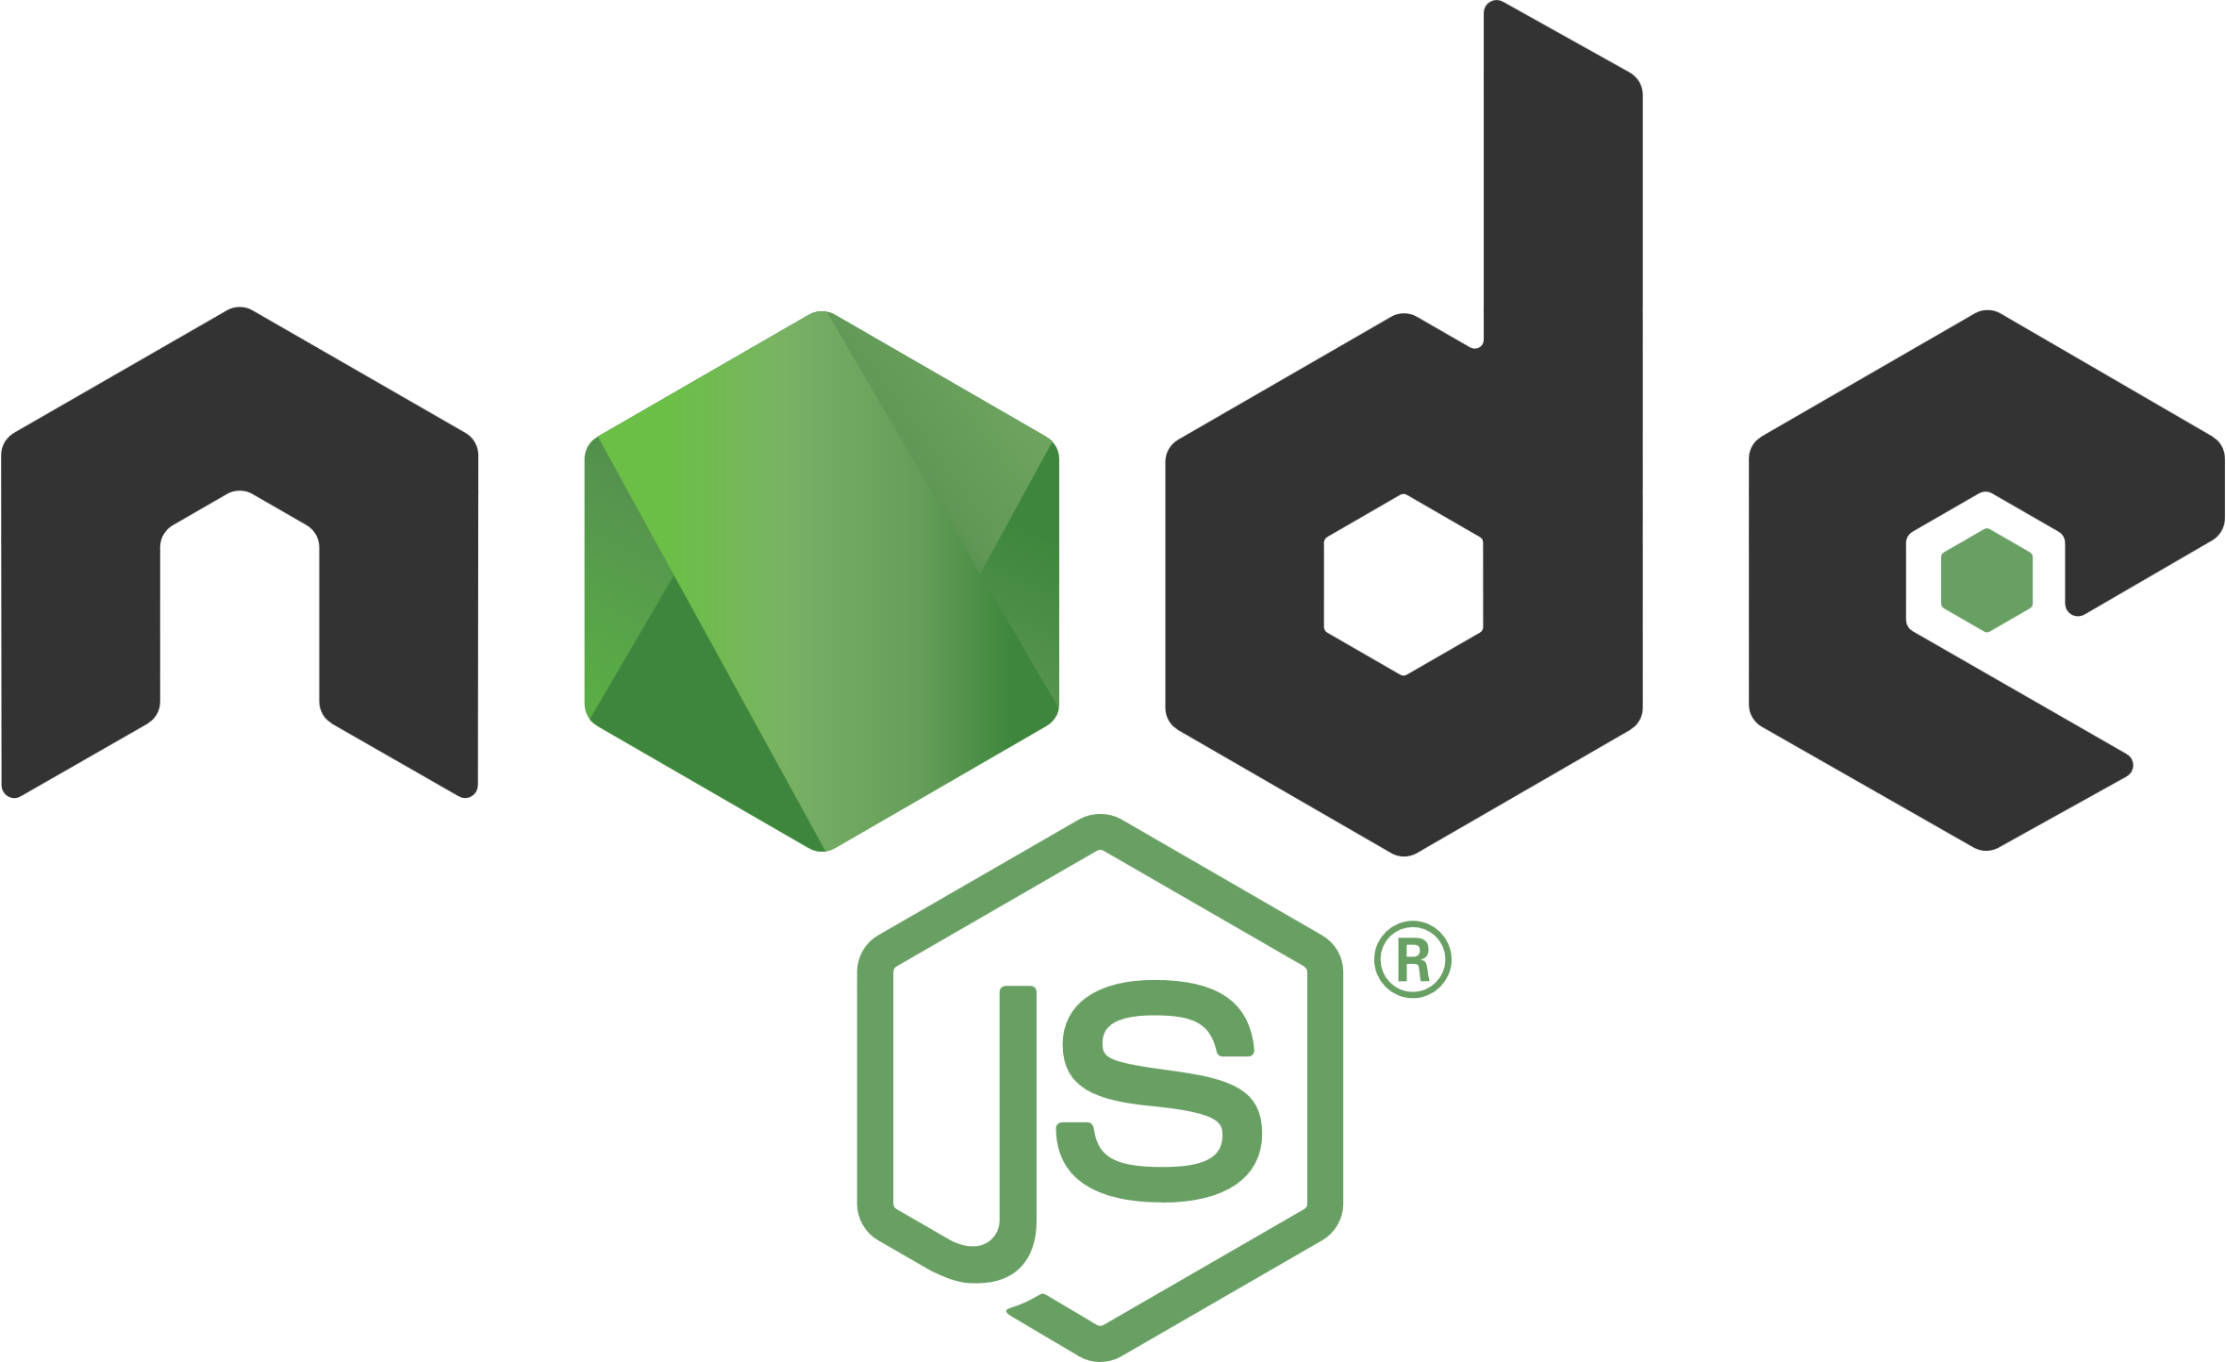
Language options
Generally available
Public preview

Slide 4
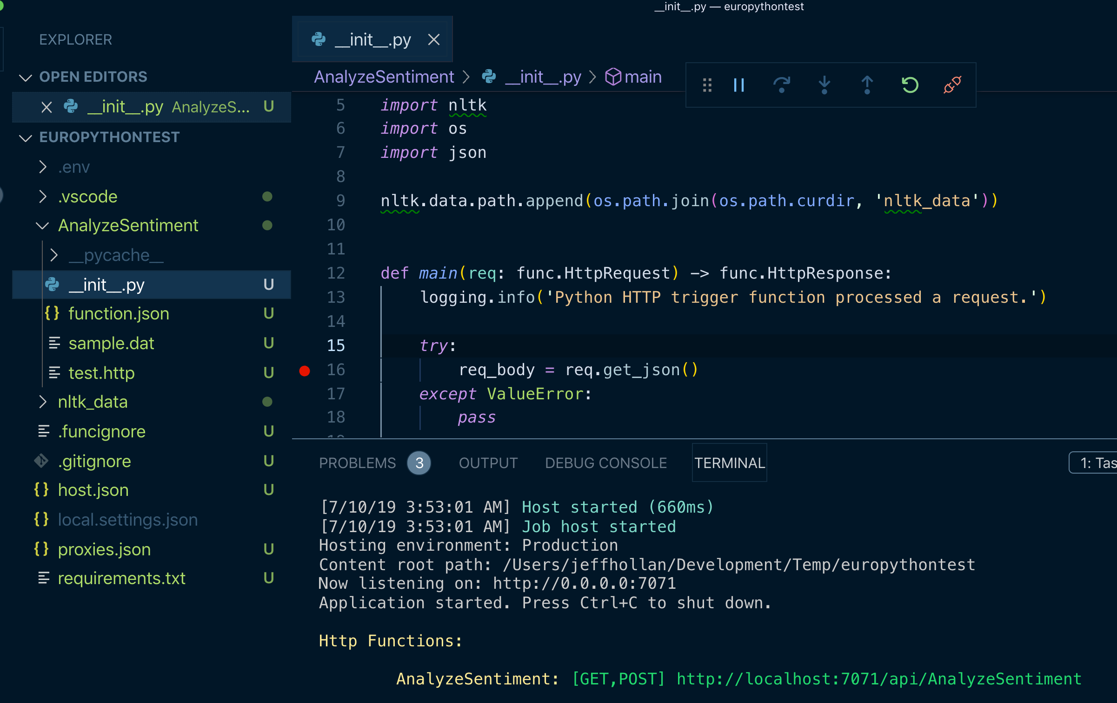
Python azure functions
100% open sourced
First-class integration with VS Code and CLI
Trigger Python code on dozens of sources
Serverless scale and pricing
Real time monitoring with Azure Application Insights
Setup seamless CI/CD with Travis CI, Azure DevOps, and others

Slide 5
DEMO: Building a serverless python api

Slide 6
Next steps and resources
Azure Functions Python QuickStart – http://aka.ms/pyfunctions-quickstart
Python video walkthrough – http://aka.ms/pyfunctions-video
ServerlessLibrary.net
Code sample from today - github.com/jeffhollan/functions-python-textblob-sentiment
Come talk to us at the booth! (and get some swag)
Follow us for the latest news updates - @jeffhollan @AzureFunctions

